Slide 1


FIT9136 PASS WEEK 9
Introduction to Python Library and Packages
30th Sep 2024
CL_33 Innovation Walk, Room C107 / Online

Slide 2





Attendance & Resources
Any questions? Email me: harry.wang1@monash.edu
Also find the drive to receive the weekly slides: https://tinyurl.com/FIT9136-PASS
Want to have GitHub Repo to access them? GitHub: https://github.com/chiefhaowang/PASS-Weekly
SSH: git@github.com:chiefhaowang/PASS-Weekly.git
HTTPS: https://github.com/chiefhaowang/PASS-Weekly.git
Monday 2-3pm
Tuesday 9-10am
Tuesday 4-5pm

Slide 3
Agenda
01
Searching & Sorting & Time Complexity - 15 mins
Concept recap
02
Leetcode - 35 mins
Two practice: warm-up + actual task
03
Closure speaking - 10 mins
Conclusion + Q&A + Attendance recording

Slide 4
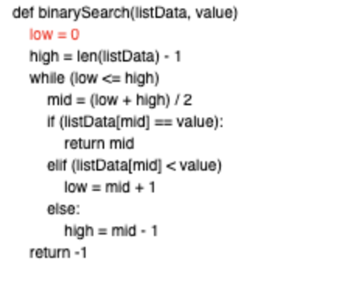
Searching - Binary Search
Finding a target value in a sorted array or list by repeatedly dividing the search interval in half. It compares the target value to the middle element, eliminating half of the search space with each step, until the target is found or the search space is empty. Binary search has a time complexity of O(log n)
Animation show: https://tinyurl.com/binary-search111

Slide 5
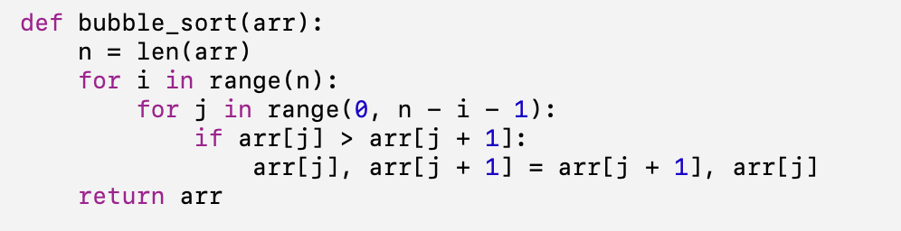
Sorting - Bubble Sort
Bubble sort is a simple sorting algorithm that repeatedly steps through a list, compares adjacent elements, and swaps them if they are in the wrong order. This process is repeated until the list is sorted. It has a time complexity of O(n²) in the worst and average cases, making it inefficient for large datasets.
Animation show:
https://tinyurl.com/bubble-sort111

Slide 6
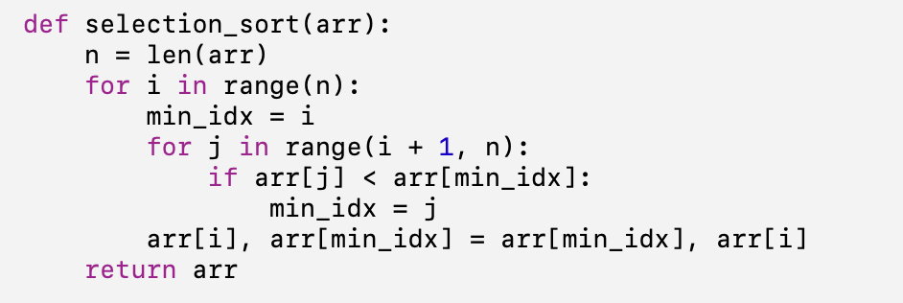
Searching - Selection Sort
Selection sort is a simple sorting algorithm that repeatedly finds the smallest (or largest) element from the unsorted portion of the list and swaps it with the first unsorted element. This process is repeated until the entire list is sorted. It has a time complexity of O(n²).
Animation show:
https://tinyurl.com/bubble-sort111

Slide 7
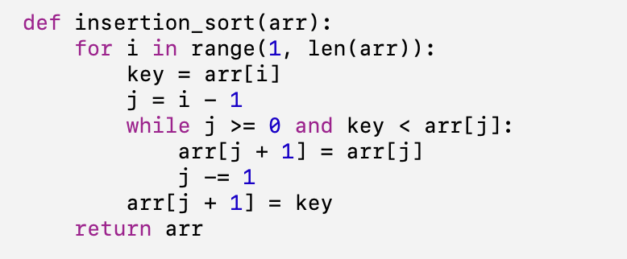
Searching - Insertion Sort
Insertion sort is a simple sorting algorithm that builds a sorted portion of a list one element at a time. It picks each element from the unsorted portion and places it in the correct position within the sorted portion. It has a time complexity of O(n²) in the worst case, but performs better on nearly sorted data.
Animation show:
https://tinyurl.com/bubble-sort111

Slide 8
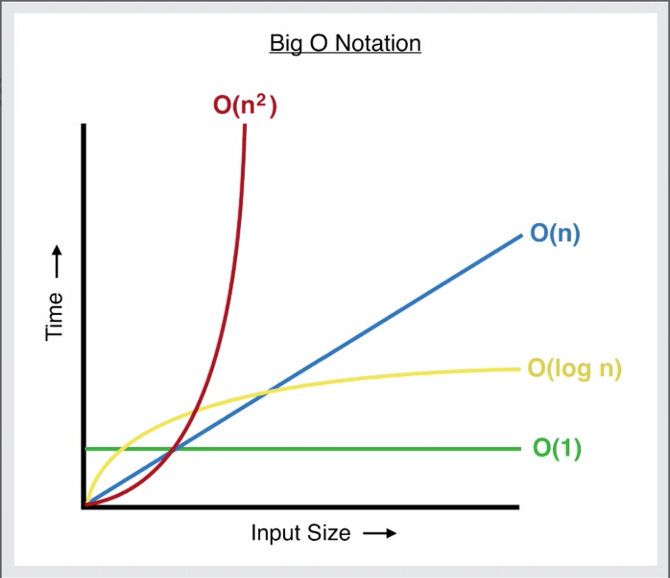
Time Complexity - O()
Common Time Complexities:
O(1): Constant time (fastest).
O(log n): Logarithmic time (e.g., binary search).
O(n): Linear time (e.g., single loops).
O(n²): Quadratic time (e.g., nested loops like bubble sort).
O(2ⁿ): Exponential time (very slow, brute-force).

Slide 9
Leetcode - warmup
Write a Python program that randomly generates m*n integers
Sorts the list in non-decreasing order using bubble sort
Reshapes it into a 2D matrix:
Each row is sorted in non-decreasing order
The first element of each row is greater than the last element of the previous row.
Base Code: https://tinyurl.com/FIT9136-PASS/week10/bubble_sort.py
Solution: https://tinyurl.com/FIT9136-PASS/week10/solution/bubble_sort_solution.py

Slide 10
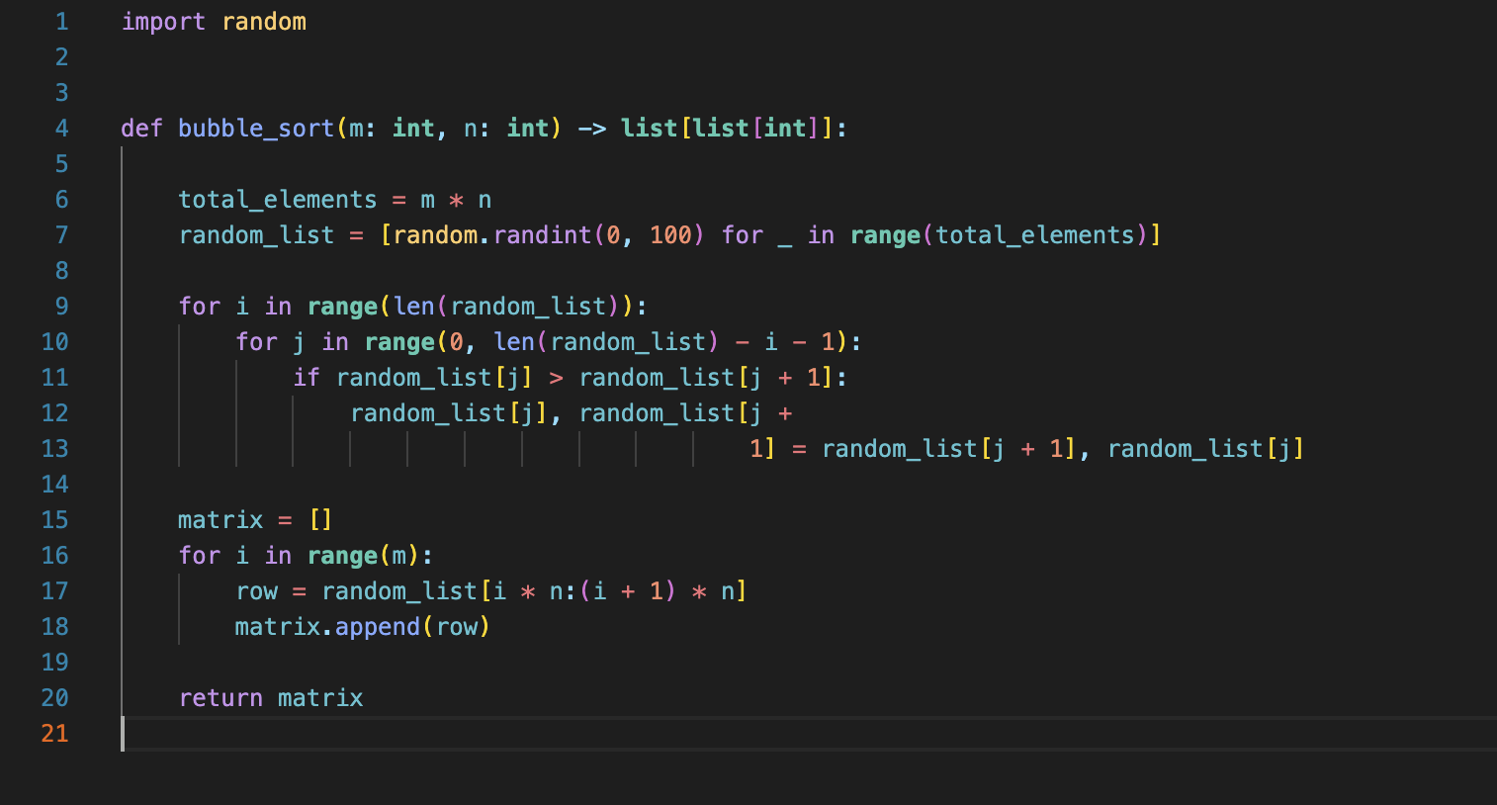
Leetcode - warmup solution

Slide 11
Leetcode - 74
Code Challenge Description: https://tinyurl.com/leetcode-2d-matrix
Base code: https://tinyurl.com/FIT9136-PASS/week10/search_2d_matrix.py
Check Result: https://tinyurl.com/leetcode-2d-matrix
Solution: https://tinyurl.com/FIT9136-PASS/week10/search_2d_matrix_solution.py
The use of Chatgpt:
Search for the function to use
Get clues of problem solving

Slide 12
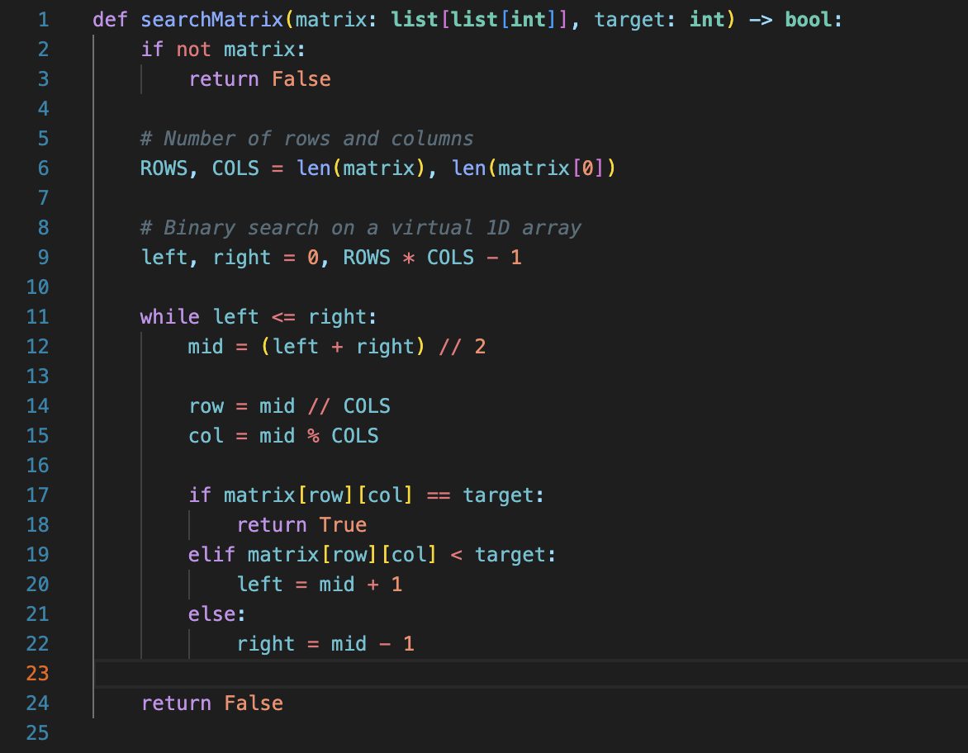
Leetcode - solution
Youtube Videos: https://www.youtube.com/watch?v=Ber2pi2C0j0&t=2s&ab_channel=NeetCode

Slide 13

Let’s see what we got today
How to use searching and sorting

Slide 14
Attendance & Resources
Any questions? Email me: harry.wang1@monash.edu
Also find the drive to receive the weekly slides: https://tinyurl.com/FIT9136-PASS
Want to have GitHub Repo to access them? GitHub: https://github.com/chiefhaowang/PASS-Weekly
SSH: git@github.com:chiefhaowang/PASS-Weekly.git
HTTPS: https://github.com/chiefhaowang/PASS-Weekly.git
Monday 2-3pm
Tuesday 9-10am
Tuesday 4-5pm

Slide 15
Thank You
30th Sep 2024
CL_33 Innovation Walk, Room C107 / Online

Slide 16
Questions & Answers
30th Sep 2024
CL_33 Innovation Walk, Room C107 / Online

